Slide 1
VADODARA INSTITUTE OF ENGINEERING Institute Code : 080

Slide 2
HYDROLOGICAL CYCLE, DAMS, BARRAGES, WIERS
Name and enrollment no. : ANAND PATEL 130800119054
SIMRAN HASRAJANI 130800119031
SHIV PATEL 130800119076
KETUL PATEL 130800119068
Subject : ELEMENTS OF CIVIL ENGINEERING
Branch & Division : MECHANICAL -I
Semester : I
Academic year : 2013-14
Guide : Asst. Prof. Nirav Patel

Slide 3
HYDROLOGICAL
CYCLE

Slide 4
DEFINATION:
Cycle that involves the continuous circulation of water in the Earth-atmosphere system.
Water is transferred from the oceans through the atmosphere to the continents and back to the oceans by means of evaporation, transpiration, precipitation, interception, infiltration, subterranean percolation, overland flow, runoff, and other complex processes. Although the total amount of water within the cycle remains essentially constant, its distribution among the various processes is continually changing.

Slide 5
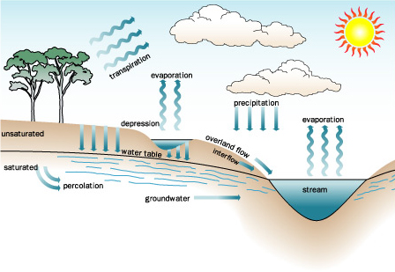

Slide 6
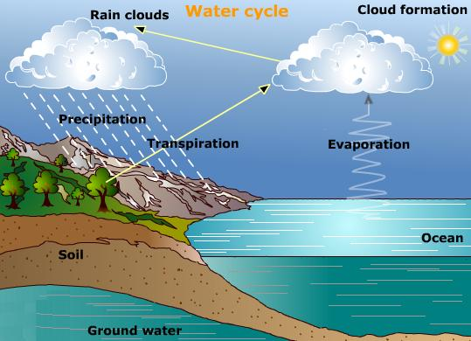

Slide 7
MAIN COMPONENTS OF IT:
1. Evaporation
2. Transpiration
3. Precipitation
4. Infiltration
5. Condensation
6.Run off
7.Ground water flow.

Slide 8
1.
What is evaporation?
Water rising into the air and changing into a gas is the process called evaporation. This is caused by high temperature, high wind and low humidity

Slide 9
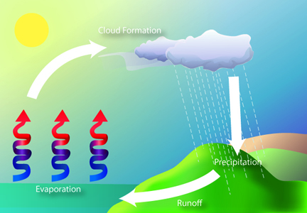

Slide 10
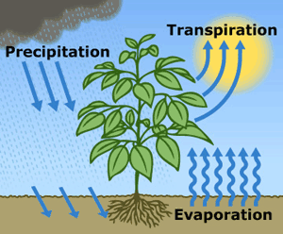
2.
TRANSPIRATION:
The rate of transpiration is the amount of water vapor that a plant loses from its leaves and stems per unit of time, depending on a number of biotic and abiotic factors.

Slide 11
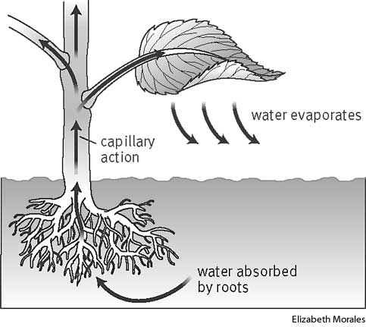

Slide 12
3.
precipitation
Precipitation in chemistry is the formation of solids from a solution. In metrology, precipitation is the formation of clouds from water vapour that rises to the atmosphere and cools to form clouds which later pour rain or snow.

Slide 13
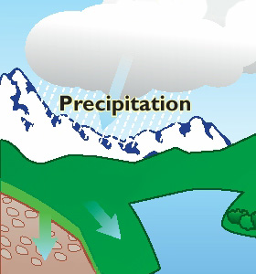
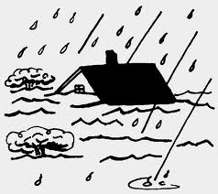
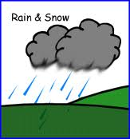
Precipitation
e.g.:
Precipitation = Run Off + Evaporation
P = R + E

Slide 14
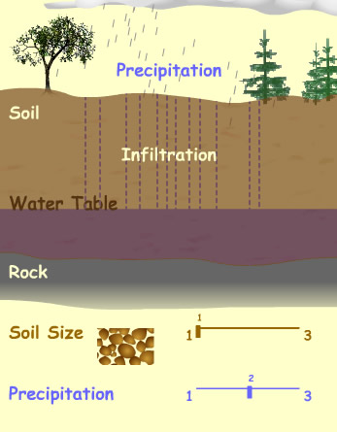
4. INFILTRATION:
Infiltration is the process by which water on the ground surface enters the soil.

Slide 15
5.CONDENSATION
A condensate is a liquid that is formed as a result of vapour cooling down and settling into a cold region or surface. The term may also refer to any substance

Slide 16
6.RUN OFF:
Surface water runoff is a step in the water cycle on Earth. When precipitation occurs, water only has a few locations where it can go. Water can infiltrate into the ground, evaporate, or become runoff.

Slide 17
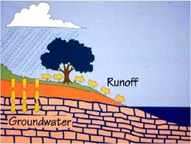

Slide 18
7.GROUND WATER:
the water beneath the surface of the ground, consisting largely of surface water that has seeped down: the source ofwater in springs and wells

Slide 19
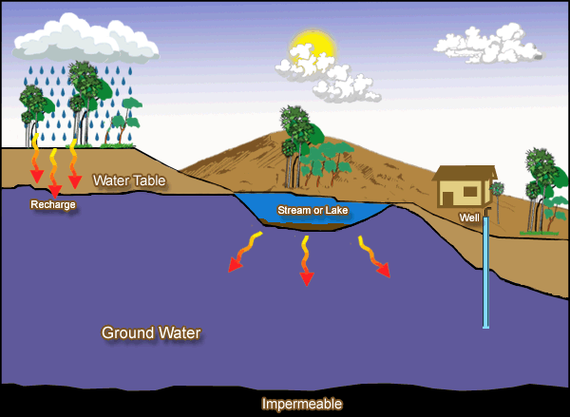

Slide 20
WATER AND ITS CONSERVATION
Water Conservation refers to reducing the usage of water and recycling the waste water for different purposes such as cleaning, manufacturing, and agricultural irrigation.
Water Conservation is the practice of saving water and reducing wastefulness.
Only 3% of the water on earth is fresh, so water conservation is an important practice to sustain our survival over the long term.

Slide 21
Water Conservation encompasses the policies, strategies and activities to manage fresh water as a sustainable resource to protect the water environment and to meet current and future human demands

Slide 22
INTRODUCTION
TO
DAMS

Slide 23
Dams are massive barriers built across rivers and streams to confine and utilize the flow of water for human purposes such as irrigation and generation of hydroelectricity. This confinement of water creates lakes or reservoirs. The first known dam was built in 2900 B.C. across the Nile River to protect the city of Memphis from flooding. Dam build was continued into the time of the Roman empire, after which dam construction was literally lost until the 1800s. Dams are a structure also seen in nature - beavers build dams to keep the water deep enough to cover the openings to their homes, protecting them from predators.

Slide 24
What Is the Purpose of a Dam?
Dam have several functions such as flood
control, navigation, water supply,
power generation and even recreation.
A Dam is basically concrete blocks built on
a river to back up the water on one side.
There are other Dams that assist in
navigation
which locks and spillways,
which also aid in flood control.

Slide 25
Advantages of Dams
Regulate water flow and Flood Control
Sediment Control
Drought Control
Time for endangered species to be moved
To another suitable location.
Irrigation
Navigation Improvement
Generation of hydro-electric power
Can be made to suit geology, can be placed in narrow and
Wide valleys. In rock or soil types.

Slide 26
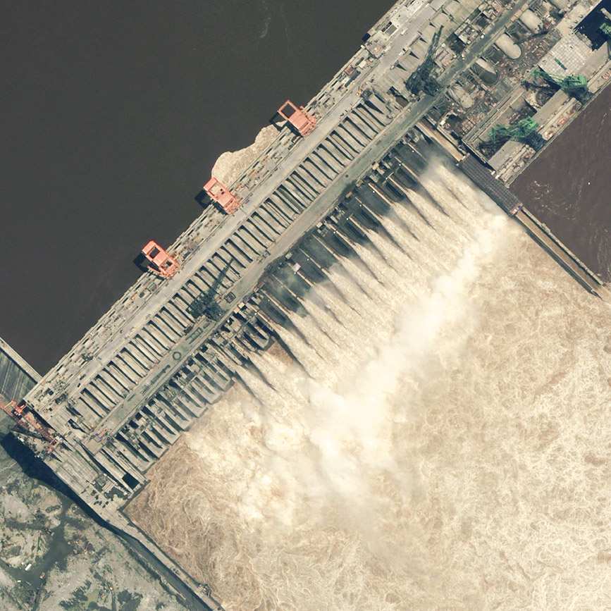
Looking at three Gorges Dam scheme in China.
What were its advantages?
Prevent flooding
Hydro-power electricity
Irrigation (agriculture)
Domestic use
Navigation

Slide 27
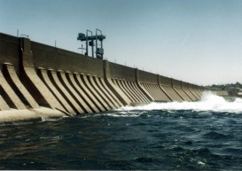
Advantages of the awesome dam:
Prevent flood and drought catastrophic conditions
For irrigation
4000km²s of dessert can now be used by farmers
Floodplain has been converted from 1 crop rotation
to 3 crop rotation.
Hydro-electricity.
Countries income has increased by 500 million per year
Since it was built.

Slide 28
Disadvantages of Dams?
While seldom considered, there are many disadvantages
of dams.
For starters, dams are extremely expensive to build. They must operate for a long period of time to finally
cover the cost, and be able to generate a profit.
Flooding large areas of land robs people of their homes,
and farms. In addition, there is also environmental
changes that occur from changing things geographically.
It is been proven that changes resulting from building the Hoover Dam triggered numerous earthquakes.
Although dams have a purpose they need to be a wisely considered plan, not a haphazard decision.

Slide 29
Saradar sarovar dam:
The Sardar Sarovar Dam is a gravity dam on the Narmada River near Navagam, Gujarat, India. It is the largest dam and part of the Narmada Valley Project, a large hydraulic engineering project involving the construction of a series of large irrigation and hydroelectric multi-purpose dams on the Narmada River. The project took form in 1979 as part of a development scheme to increase irrigation and produce hydroelectricity. It is the 30th largest dams planned on river Narmada, Sardar Sarovar Dam (SSD) is the largest structure to be built. It has a proposed final height of 163 m (535 ft) from foundation. The dam is one of India's most controversial dam projects and its environmental impact and net costs and benefits are widely debated. The World Bank was initially a funder of the SSD, but withdrew in 1994. The Narmada Dam has been the centre of controversy and protest since the late 1980s.

Slide 30
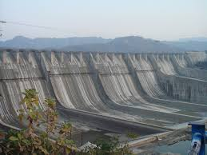
SARADAR SAROVAR DAM

Slide 31
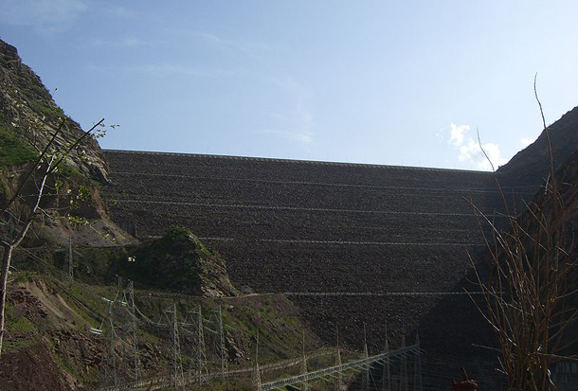
World’s 1st tallest dam:
This earth fill embankment dam on the
Vakhsh River in Tajikistan is currently
the tallest dam in the world at 300 meters.

Slide 32
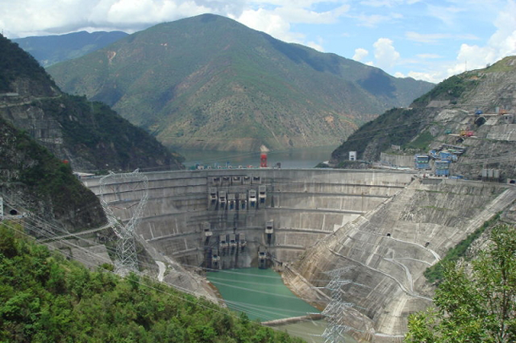
World’s 2nd tallest dam:
An arch dam on the Lancang (Mekong)
River in China with 292 meter,
its primary purpose is to provide hydroelectric power.

Slide 33
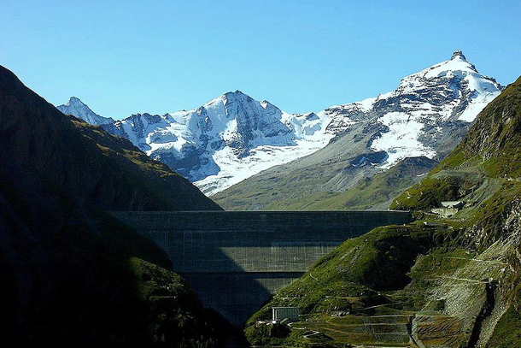
World’s 3rd tallest dam:
A concrete gravity dam on the Dixence River in Switzerland,
at 285 meters it is the tallest of its kind in the world.

Slide 34
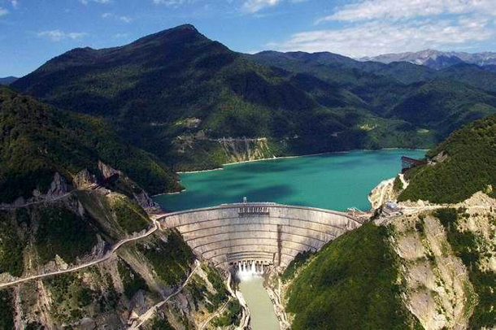
World’s 4th tallest dam:
This hydroelectric dam on the Inguri River in Georgia
is the second highest concrete arch dam in the world

Slide 35
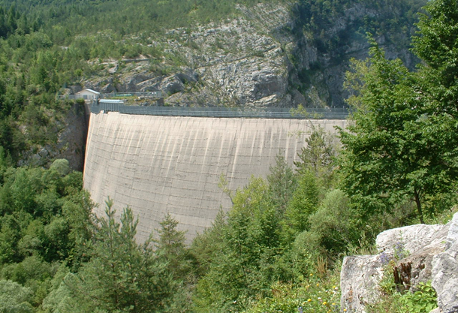
World’s 5th tallest dam:
A disused dam north of Venice, Italy,
in 1963 a landslide caused
the overtopping of the dam and around 2,000 deaths.

Slide 36
Sardar sarovar dam

Slide 37
WEIRS::

Slide 38
WEIRS:
A low wall or dam built across a stream or river to raise the level of the water or to change the direction of its flow

Slide 39
Weirs allow hydrologists and engineers a simple method of measuring the volumetric flow rate in small to medium-sized streams or in industrial discharge locations. Since the geometry of the top of the weir is known and all water flows over the weir, the depth of water behind the weir can be converted to a rate of flow. The calculation relies on the fact that fluid will pass through the critical depth of the flow regime in the vicinity of the crest of the weir. If water is not carried away from the weir, it can make flow measurement complicated or even impossible.

Slide 40
Weirs, referred to as low head barrier dams in this context, are used in the control of invasive sea lamprey in the Great Lakes. They serve as a barrier to prevent recolonization by lamprey above the weir, reducing the area required to be treated with lampricide, and providing a convenient point to measure water flow

Slide 42
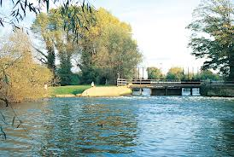

Slide 43
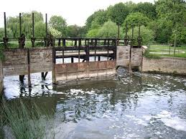

Slide 44
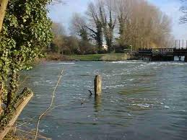

Slide 45
BARRAGES:

Slide 46
BARRAGES
A barrage is a type of low-head, diversion dam which consists of a number of large gates that can be opened or closed to control the amount of water passing through the structure, and thus regulate and stabilize river water elevation upstream for use in irrigation and other systems. The gates are set between flanking piers which are responsible for supporting the water load of the pool created. While the term barrage is borrowed from the French word meaning a dam generally, its usage for such a structure in English is chiefly in Pakistan, India, Egypt, Iraq, and other countries in the Middle East.^{[1]}

Slide 47
According to the World Commission on Dams, a key difference between a barrage and a dam is that a dam is built for water storage in a reservoir, which raises the level of water significantly. A barrage is built for diverting water, and raises the water level only a few feet; they are generally built on flat terrain across wide, often meandering rivers. Barrages are larger than headworks.

Slide 48
Barrages that are commonly used to dam a lagoon or estuary as a method to capture tidal power from tidal inflows are known as tidal barrages.

Slide 49
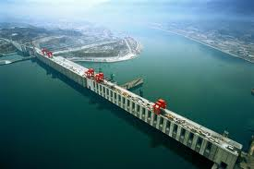

Slide 50
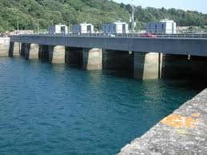

Slide 51
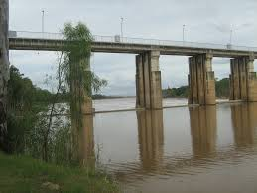

Slide 52
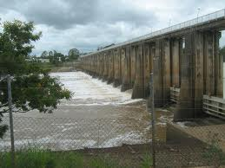

Slide 53
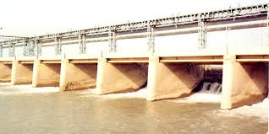

Slide 54
CHECK DAM:

Slide 55
Objective
In stream storage.
Ground Water recharge
Incidental irrigation during late Khariff and Rabi by storing water at the end of monsoon mainly through lifting devices.
Irrigation use of water flowing down drainage channels.
Other uses like Drinking water, bathing, washing, fishing, recreation etc.

Slide 56
Selection Criteria
Blocks having less than 35% irrigation coverage to be considered on priority.
Areas where farmers are using traditional irrigation by constructing temporary cross bunds on streams.
Where the farmers are willing to take up operation & maintenance of the structure.
The newly constructed structure should not have any adverse impact on the hydrological efficacy of the existing, ongoing and future major, medium, minor (flow) irrigation and minor (lift) irrigation projects.
In-stream storage will be developed near urban centers if suitable rivers and locations available for multipurpose domestic and irrigation use.

Slide 57
Salient Features & Types of Check Dams
Check dams, up to a height of 2.0 mt. can be constructed across small tributaries / nallah / drainage channel within the banks and streams in middle and higher reaches (within approx. 50 mts. wide) : Low cost structures, irrigation by beneficiaries through own arrangements - lift or flow, operated by beneficiaries. Diversion weir type structure.
Check dams in deltaic rivers/ drainage channel (lower reaches) (within approx 50 mts. wide) : Mostly for irrigation through lift, operated by beneficiaries.
Storage across major rivers and streams having higher width and huge flood water discharge: Irrigation purpose, to be operated by Department.

Slide 58
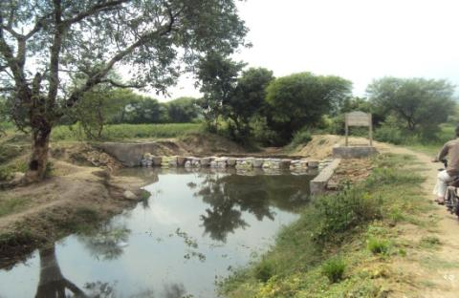
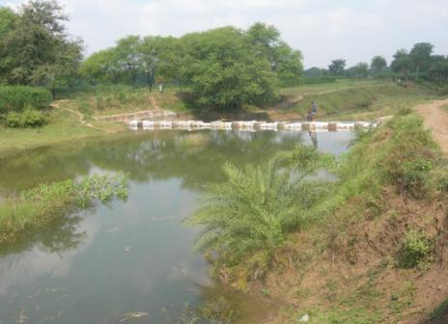
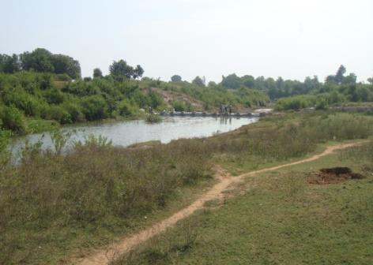
Check Dams closed by Sand Bags

Slide 59
THANKS

